Slide 1

BANO QABIL 4.0
PROJECT
FINAL
Presented By: Hafiza Iqra Shaheen

Slide 2
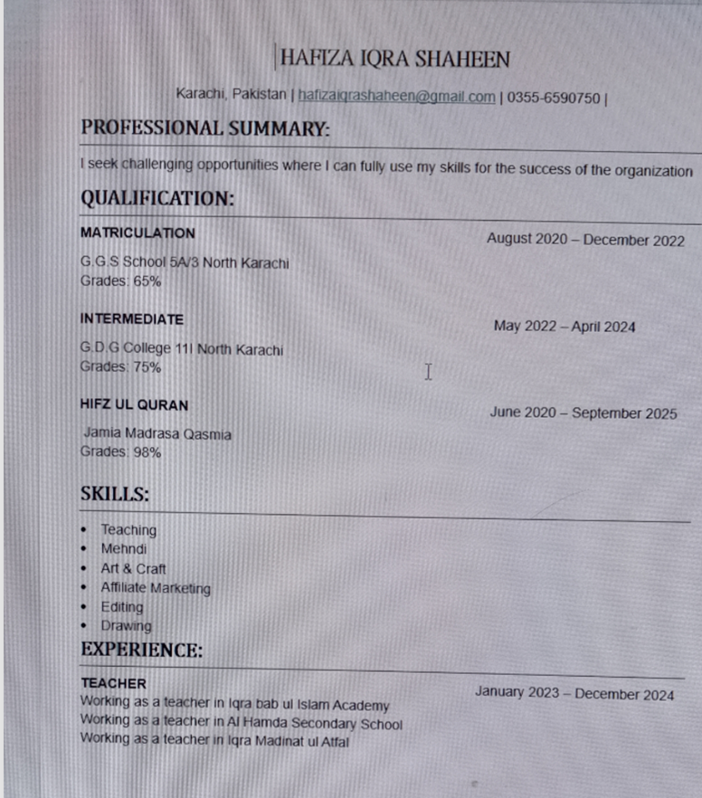
Resume
I am a dedicated and motivated professional with strong skills in data management, reporting, and organization. Proficient in MS Excel and other digital tools, I bring accuracy, efficiency, and problem-solving abilities to every task. I am seeking an opportunity to contribute to a dynamic organization where I can grow and add value through my skills and dedication.

Slide 3
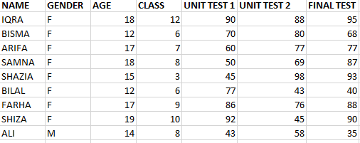
Spread Sheet
I created a spreadsheet in Excel to organize and manage data in a clear and structured way. The spreadsheet includes rows and columns that allow easy entry, calculation, and analysis of information. By using formulas, formatting, and functions, the spreadsheet makes data more accurate and meaningful. This helps in saving time, improving efficiency, and presenting the information in a professional format.

Slide 4
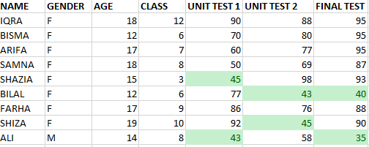
Conditional Formating
I applied conditional formatting in Excel to make the data easier to understand and analyze. This feature highlights specific values based on given conditions, which helps in quickly identifying important patterns, trends, or errors. For example, cells automatically change color when they meet certain criteria, making the spreadsheet more interactive and visually clear. Conditional formatting improves decision-making by allowing data to stand out and be interpreted more effectively.

Slide 5
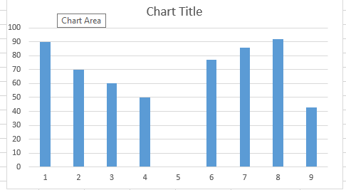
CHART
The chart created in Excel clearly represents the data in a visual format, making it easier to compare trends and analyze results. By using this chart, patterns and key insights become more visible, allowing for better decision-making. It highlights the relationship between the values and provides a clear summary of the information in an organized way.

Slide 6
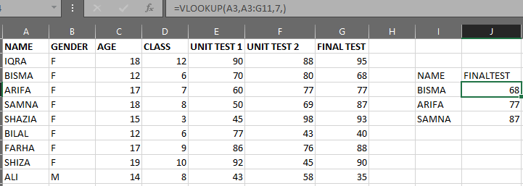
VLOOKUP
I used the VLOOKUP function in Excel to quickly search for and retrieve specific information from a large dataset. This function allows me to look up a value in one column and return the corresponding data from another column. By applying VLOOKUP, the process of finding information becomes faster, more accurate, and efficient. It is especially useful for managing records, analyzing data, and avoiding manual errors.

Slide 7
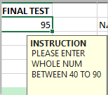
DATA VALIDATION
.
I applied Data Validation in Excel to control and restrict the type of data that can be entered into a cell. This feature helps maintain accuracy and consistency by allowing only specific values or ranges, such as whole numbers, dates, or predefined lists. By using data validation, errors are reduced, and the spreadsheet becomes more reliable and professional.

Slide 8
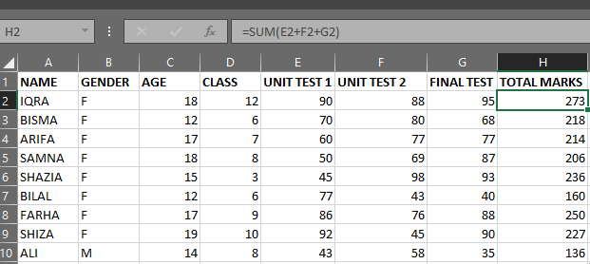
SUM IN MS EXCEL
I used the SUM function in Excel to quickly add a range of numbers. This function makes calculations faster and reduces errors compared to manual addition. By applying SUM, I was able to find totals accurately and save time when working with large amounts of data. It is a simple but powerful tool for financial records, reports, and data analysis.

